Slide 1



Slide 2
What is air pollution?
Particles and gases in the air that isn’t good for us or the environment.
Notes:
Air pollution is a mixture of particles and gases that get released into the air and isn’t good for us or the environment.

Slide 3
Can we see air pollution?
Notes:
Do you think we can see air pollution?
Hands up for yes, hands up for no

Slide 4
No, Air pollution is too small for us to see
Human hair
Air pollution
Notes:
In fact, we cannot see air pollution, the particles are far too small for us to see with our eyes. To give you an idea of their size, imagine if a strand of your hair was this size, this would then be the size of air pollution particles!
Air pollution also doesn’t usually have a smell, so we often don’t know that we are breathing it in.

Slide 5
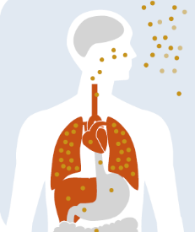



How Does air pollution affect us?
Air pollution can affect us in different ways
Hurt our hearts
Hurt our lungs
Make asthma worse
Notes:
Breathing in air pollution can make us feel poorly. It can hurt our hearts and our lungs and it can make asthma worse.
Everyone can be affected by air pollution but children, older adults and people with breathing problems like asthma are most likely to be affected.

Slide 6
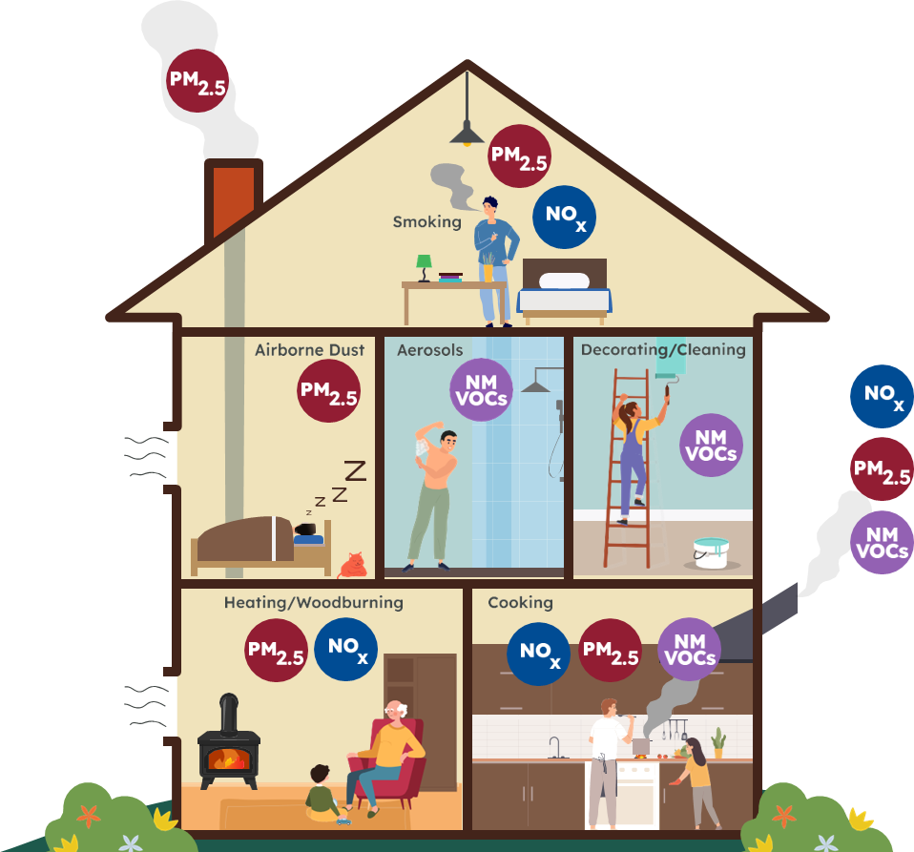
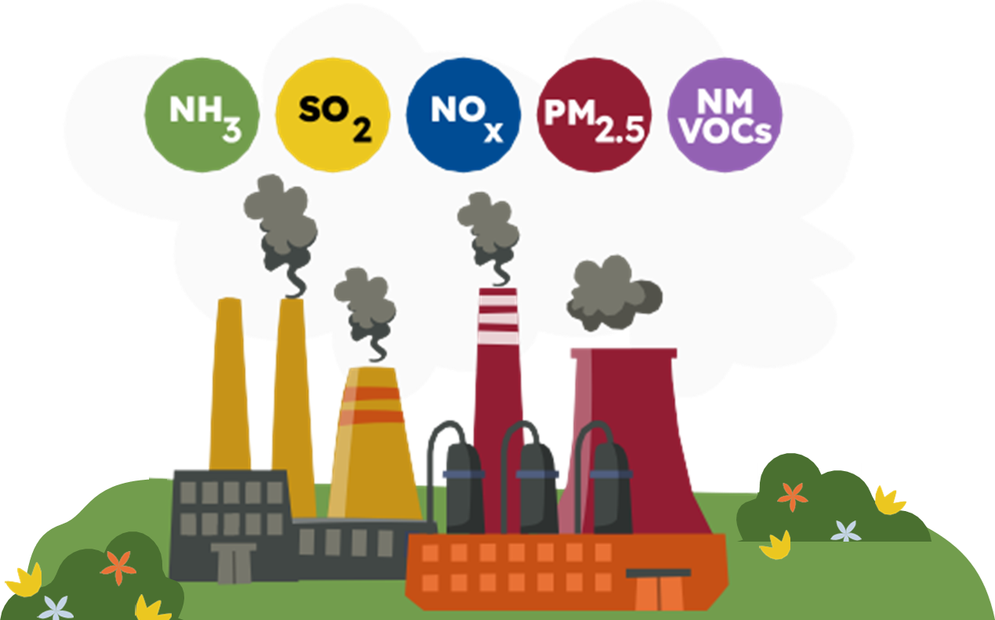
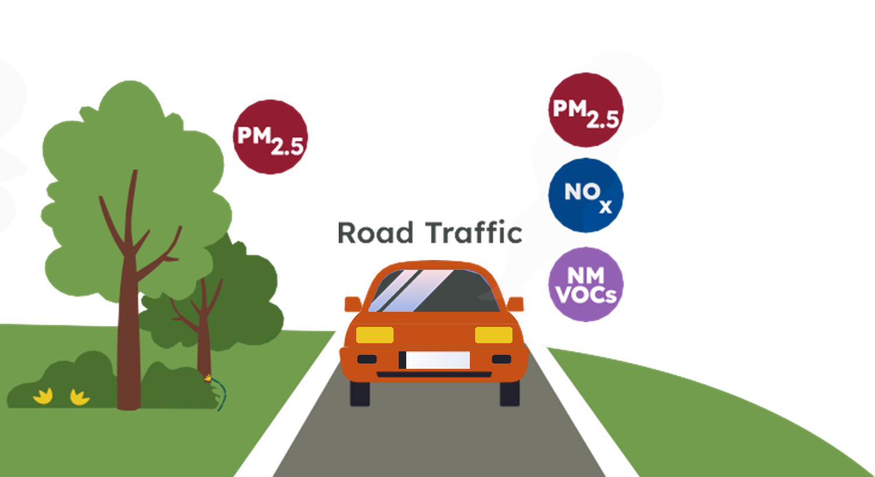
What causes air pollution?
Indoor Air Pollution
Industry & Agriculture
Road Transport
Notes:
There are lots of causes of air pollution such as industry and agriculture, road transport and indoor air pollution sources like aerosols, cooking, woodburning and painting.
Which of these do you think is the biggest source of air pollution? Hands up for industry and agriculture, hands up for road transport, hands up for indoor air pollution.

Slide 7
What causes air pollution?
Road traffic produces the most air pollution in Essex.
Notes:
Road transport is the produces the most air pollution in Essex
This is from petrol and diesel engines in cars, vans, lorries and buses.

Slide 8
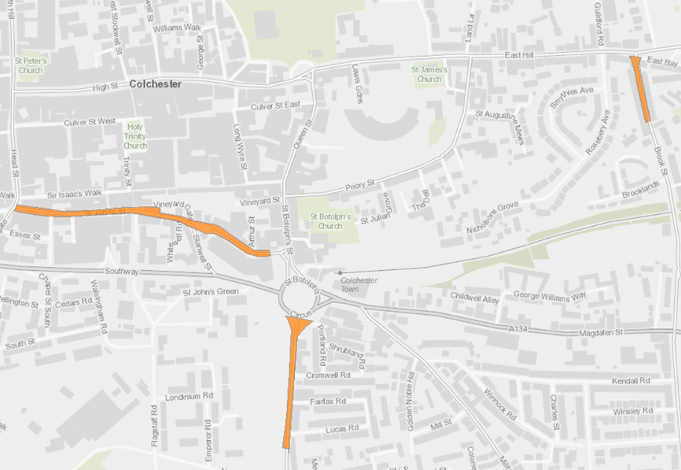
Air Pollution in Colchester
Narrow streets can trap air pollution causing it to build up to unsafe levels.
Notes:
In Colchester, air pollution from road transport can get trapped in narrow streets with buildings on either side. The concentration builds up when there is lots of traffic and can reach unsafe levels.
There are 3 areas in Colchester when air pollution is higher than it should be and therefore, we need to take action to reduce it. These areas are shown in orange on the map.

Slide 9
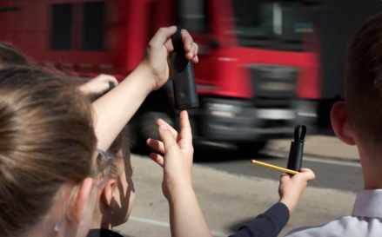
Measuring air pollution
Air pollution monitors take in air and calculate how much pollution is present.
Notes:
Because air pollution is so small, we need to use specially designed air pollution monitors to measure how much air pollution is present. The monitors take in air and use different sensors and filters to calculate how much of each different air pollutant is there.
Air pollution monitors can be small and handheld, like the ones in the photo, allowing people to measure air pollution wherever they go. Or they can be bigger and stationary, measuring air pollution at a specific location over time. There are lots of air pollution monitors in Colchester that help us to see where air pollution is high. The data collected by the monitors is shared on the Essex Air website.

Slide 10

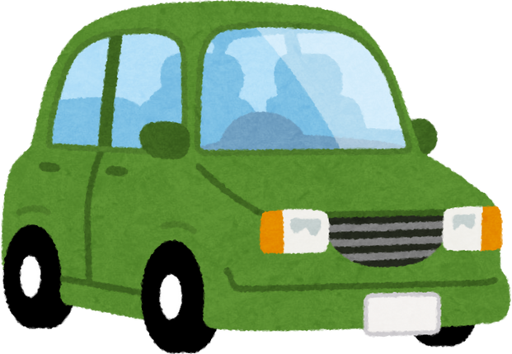


Air Pollution around schools
Air pollution is often high outside school
Lots of traffic at pick up and drop off times
Cars waiting with the engine running
Notes:
By monitoring air pollution, we know that it can be particularly high outside schools. This is because there is increased traffic at pick up and drop off times outside of schools and some cars waiting with the engine running that produces more air pollution.
This is why it is important think about how we travel to school.

Slide 11
How we travel to school
1
Walk, scoot, cycle or take the bus if you can
2
If you come by car, try park a bit further away from school and walk in
3
Reminding adults to switch off the car engine when waiting
Notes:
There are lots of different ways that we can travel to school. If you can, it is best to walk, scoot, cycle or take the bus to school. If you come to school by car, see if you can park a bit further away from school and walk the rest of the way. And it is important to remind adults to switch off the car engine when waiting. This helps to keep everyone safe outside of school.
We can also think about how we travel to the shops, to see family and friends and into the city centre. To make an even bigger impact, talk to your friends and family about what you have learnt about air pollution and encourage them to think about how they travel as well.

Slide 12

Why we like walking, scooting and cycling
Makes us feel happier and calmer
We get some exercise
Produces less air pollution
Notes:
We think that other ways to get to school, like walking, scooting and cycling are better because it makes us feel happier and calmer, we get some exercise and it produces less air pollution.

Slide 13
Small changes to how we travel add up to make a big difference to air pollution!
Notes:
If everyone makes a small change, it adds up to make a really big difference.

Slide 14
Thank you for Listening!

