Slide 1


Notes:
Hi everyone, today I want to tell you a bit out air pollution, how it affects us and what we can do to help take care of our air.

Slide 2
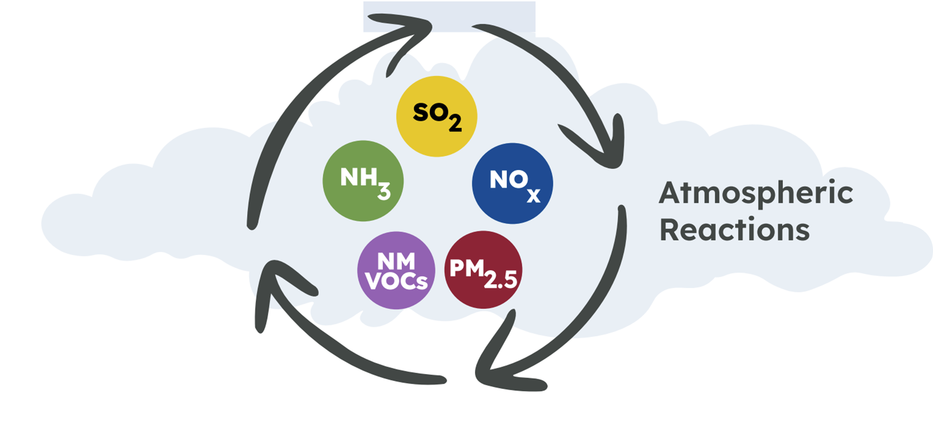
What is air pollution?
Particles and gases in the air that cause harm to us and the environment.
Notes:
Air pollution is a mixture of particles and gases that get released into the air and cause harm to us and to the environment.
The icons show some of the gases and particles that can be found in air pollution. Sulphur dioxide, Nitrogen oxides, ammonia and non-methane volatile organic compounds are all gases and particulate matter is type of particle.

Slide 3
Can we see air pollution?
Notes:
Do you think we can see air pollution?
Hands up for yes, hands up for no

Slide 4
No, Air pollution is too small for us to see
Human hair
Air pollution
Notes:
In fact, we cannot see air pollution, the particles are far too small for us to see with our eyes. To give you an idea of their size, imagine if a strand of your hair was this size, this would then be the size of air pollution particles!
Air pollution also doesn’t usually have a smell, so we often don’t know that we are breathing it in.

Slide 5
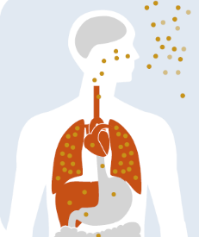



How Does air pollution affect us?
Makes heart conditions worse
Increases risk of lung disease and cancer
Can trigger infections and asthma
Notes:
Breathing in air pollution can impact our health in the short and long term. Because the particles are so small, they can pass through the lungs into the bloodstream and cause problems with every organ in our body. Air pollution can make heart conditions worse, increase risk of lung disease and cancer and trigger infections and asthma.
Everyone can be affected by air pollution but children, older adults and people with breathing problems like asthma are most likely to be affected. Air pollution is the biggest environmental risk to our health.

Slide 6
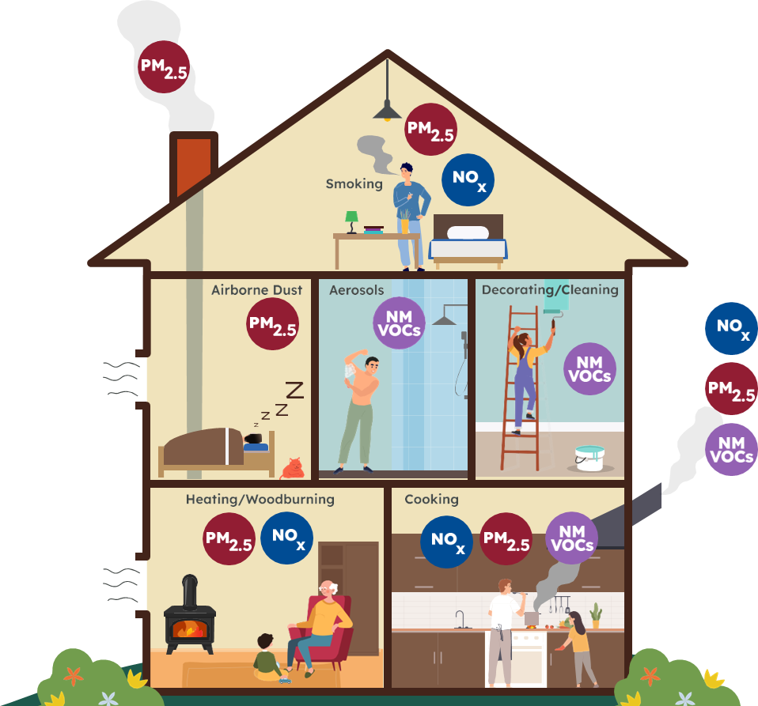
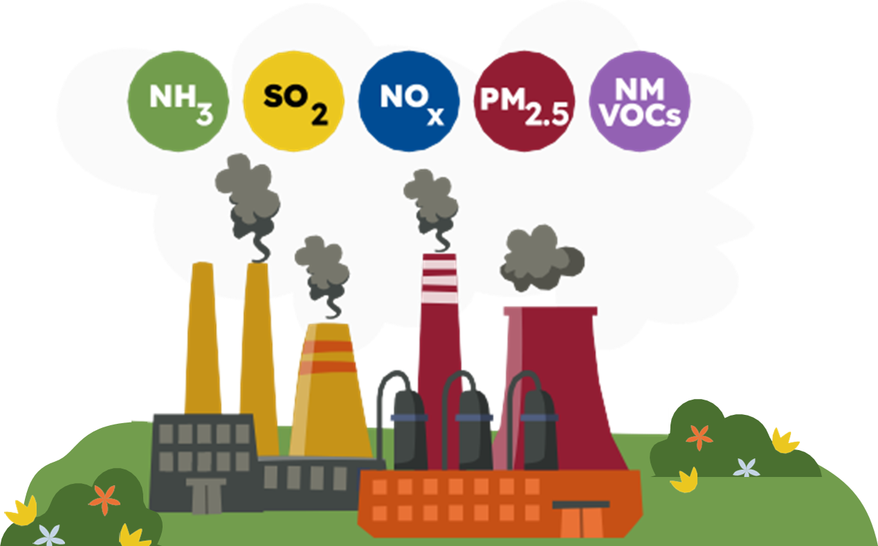
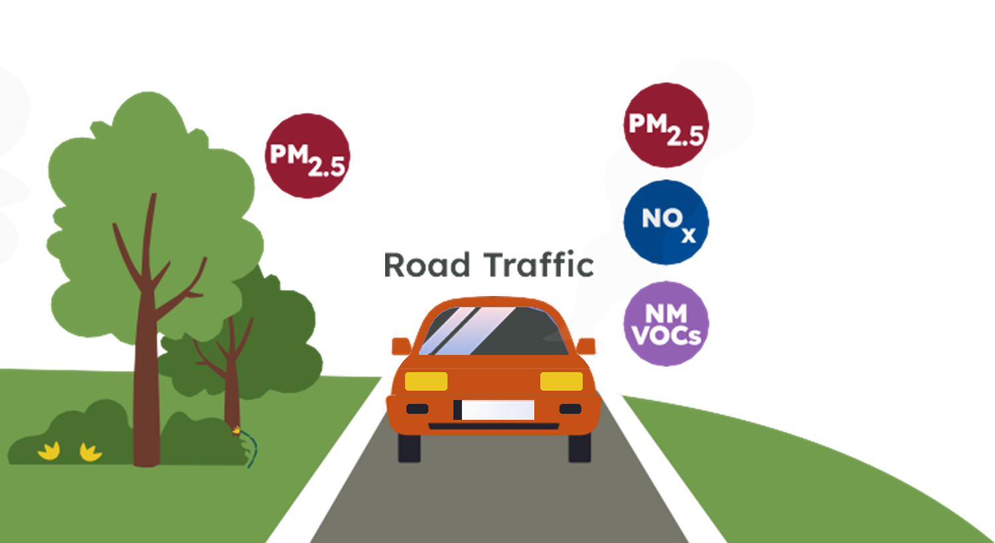
What causes air pollution?
Indoor Air Pollution
Industry & Agriculture
Road Transport
Notes:
There are lots of causes of air pollution such as industry and agriculture, road transport and indoor air pollution sources like aerosols, cooking, woodburning and painting.
Which of these do you think is the biggest source of air pollution? Hands up for industry and agriculture, hands up for road transport, hands up for indoor air pollution.

Slide 7
What causes air pollution?
Road traffic is the biggest source of air pollution in Essex.
49%
Harmful gases are produced by road traffic
Notes:
Road transport is the biggest source of air pollution in Essex and accounts for 49% of harmful gases that are produced.
These gases are produced from petrol and diesel engines in cars, buses, vans and lorries. A small amount of particles are also produced by road transport from tire wear and braking.

Slide 8
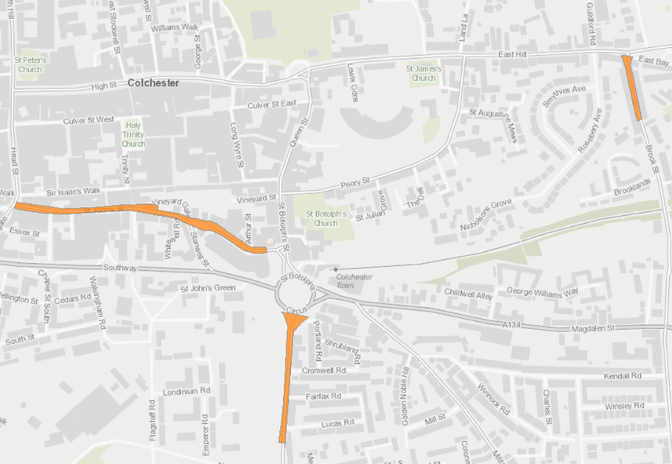
Air Pollution in Colchester
Narrow streets can trap air pollution causing it to build up to unsafe levels.
Notes:
In Colchester, air pollution from road transport can get trapped in narrow streets with buildings on either side. The concentration builds up when there is lots of traffic and can reach unsafe levels.
There are 3 areas in Colchester when air pollution exceeds the national standards and therefore, we need to take action to reduce it. These areas are shown in orange on the map: Brook Street, Mersea Road near St Botoloph’s Roundabout and St Johns and Osborne Street.

Slide 9
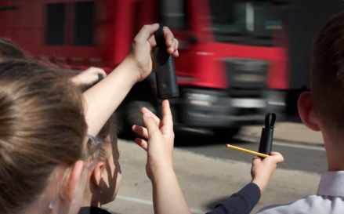
Measuring air pollution
Air pollution monitors take in air and calculate how much pollution is present.
Notes:
Because air pollution is so small, we need to use specially designed air pollution monitors to measure how much air pollution is present. The monitors take in air and use different sensors and filters to calculate how much of each different air pollutant is there.
Air pollution monitors can be small and handheld, like the ones in the photo, allowing people to measure air pollution wherever they go. Or they can be bigger and stationary, measuring air pollution at a specific location over time. There are lots of air pollution monitors in Colchester that help us to see where air pollution is high. The data collected by the monitors is shared on the Essex Air website.

Slide 10

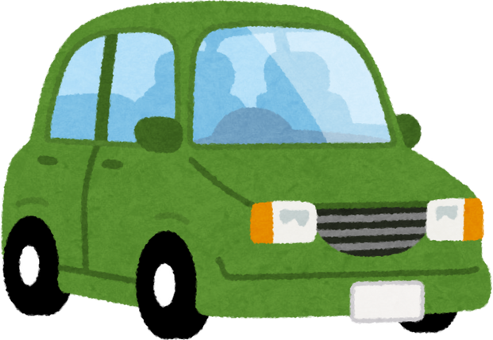


Air Pollution around schools
Air pollution can be particularly high outside schools
Increased traffic at pick up and drop off times
Cars waiting with the engine running
Notes:
By monitoring air pollution, we know that it can be particularly high outside schools. This is because there is increased traffic at pick up and drop off times outside of schools and some cars waiting with the engine running that produces more air pollution.
As children and young people are more affected by air pollution, it is important to raise awareness and encourage change to improve air quality. One way that we can do this is by thinking about how we travel to school.

Slide 11
How we travel to school
1
Walk, scoot, cycle or take the bus if you can
2
If you come by car, try park a bit further away from school and walk in
3
Reminding adults to switch off the car engine when waiting
Notes:
If you can, it is best to walk, scoot, cycle or take the bus to school. If you come to school by car, see if you can park a bit further away from school and walk the rest of the way. And it is important to remind adults to switch off the car engine when waiting. Keeping the engine running is not good for the car and uses more fuel, so switching off the engine can also help to save money.
We can also think about how we travel to the shops, to see family and friends and into the city centre. To make an even bigger impact, talk to your friends and family about what you have learnt about air pollution and encourage them to think about how they travel as well.

Slide 12



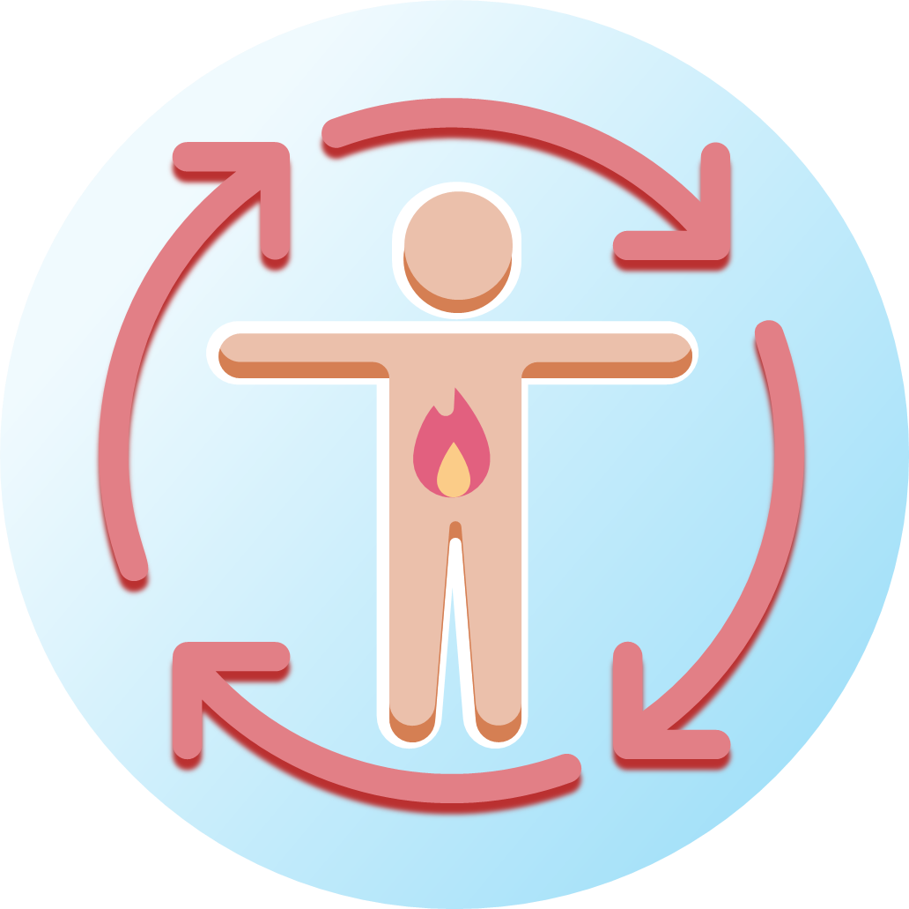

How we travel to school
Changing to active travel also has amazing benefits for our health and wellbeing!
Socialise with friends and family
Makes you feel happier
Strengthens your immune system
Improves heart health
Improves focus and memory
Boosts your metabolism
Notes:
Changing to active travel for some short journeys also has amazing benefits for our health and wellbeing.
It makes us feel happier by encouraging our bodies to release natural chemicals called endorphins.
It strengthens our immune systems, helping our bodies to fight off illnesses like cold and flu.
It boost our metabolism and helps us to stay healthy.
It is a good way to catch up with friends and family and feel more connected in our community.
It improves heart health and reduces the risk of heart disease.
And finally, it helps our mind to work better, improving focus and memory.
It can also help to save money for getting around so there are so many reasons to change our travel habits.

Slide 13
Small changes to how we travel add up to make a big difference to air pollution!
Notes:
It might feel like our individual actions won’t make a different overall, but if everyone makes just one small change, together we will make a big difference. If people who normally drive used a different mode of travel two times a week, it would remove 150,000 cars from the road every week.

Slide 14
Thank you for Listening!

